Slide 1
Google Data Analytics Project - Cyclistic
Presented by Steven A. Monserrate
Notes:
Hello everyone and welcome to my review of the Google Data Analytics Project for Cyclistic. My name is Steven A. Monserrate, and I will be walking you through my thought process and recommendations for Cyclistic.

Slide 2
Index
Introduction: 3-4
Cyclistic Conference: 5-7
Casuals vs. Members: 8-16
The Data Collecting Process: 17-28
What We Know: 29
Why Would Cyclistic Casuals Become Members?: 30
Advertising to Non-Members: 31
Notes:
The index page gives you an idea of where to find all of my data, how I organized my presentation, and my thoughts on this project. If you are looking for something specific when referencing my project, I suggest that you start here.

Slide 3

Cyclistic Bike Share
The Bike Company of the Future!
Notes:
Welcome everyone, to my presentation on Cyclistic, the Bike Share Company of the Future! :D

Slide 4
Cyclistic: The Bike Company of the Future
Cyclistic is an American bikeshare company based in the city of Chicago, IL
Cyclistic has tens of thousands of customers every month
Customers are divided into two groups, members and non-members
Notes:
Cyclistic is an Americna bikeshare company based in the city of Chicago. Our business has tens of thousands of customers every month. These customers are divided into two separate groups, members, and non-members

Slide 5
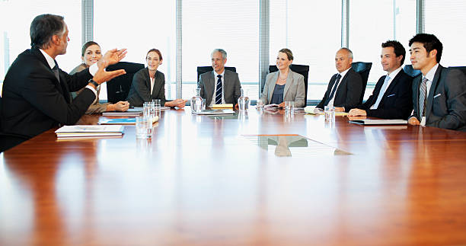
Cyclistic Conference
Notes:
Our meeting today will be reviewing problems that the company has had moving forward. As we will see in the next slide, Cyclisitic is interested in converting its non-member customers into members, and it wants to understand how to do that. My suggestions and thoughts are outlined in the slides continued.

Slide 6
The Problem
Cyclistic believes that its future is based on converting casual riders to subscribed service members
Cyclistic needs to know how members and non-members act
Cyclistic also needs to know how to advertise its services to these potential members
Notes:
Currently, Cyclisitic has more casual riders than it does members. The company believes that converting casuals into members will help sustain it well into the future. In order to do this, we will need to figure out how both categories of customer act, as well as how to advertise our services to these potential members.

Slide 7
The Mini Questions
How do casual and member riders act differently?
Why would casual riders buy Cyclistic memberships?
How can Cyclistic use media to influence its non-members to become members?
Notes:
Specifically, we will need to know how our casual and member riders act, why casuals would want to buy memberships, and how we can use media to influence our customers to subscribe to our membership service.

Slide 8


Casuals Vs. Members

Slide 9
Casual Riders vs Member Riders
There are differences and similarities between both casual and member riders
Understanding these difference and similarities shows us how to grow our membership
Understanding the bike patterns also allows us to learn how to effectively advertise to each group

Slide 10
Similarities
Riders tended to enjoy warmer months, especially April, May, June, and August
April was the most popular month of the year, boasting both longer and more frequent rides
The electric bikes were the most popular form of bikes, followed by classic and then docked

Slide 11
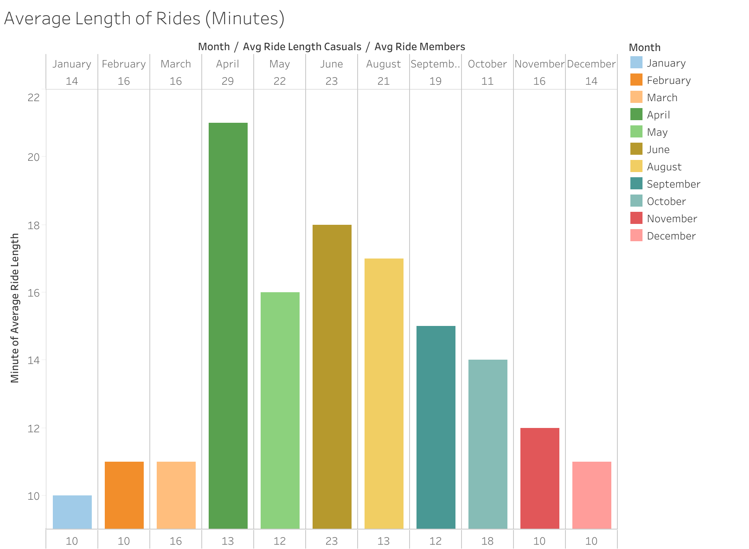
Notes:
https://public.tableau.com/app/profile/steven.monserrate/viz/GoogleDataAnalyticsProject-Cyclistic/Sheet1
On average, customers of both varieties seemed to enjoy warmer months. The casual customers tend to ride longer than the members

Slide 12
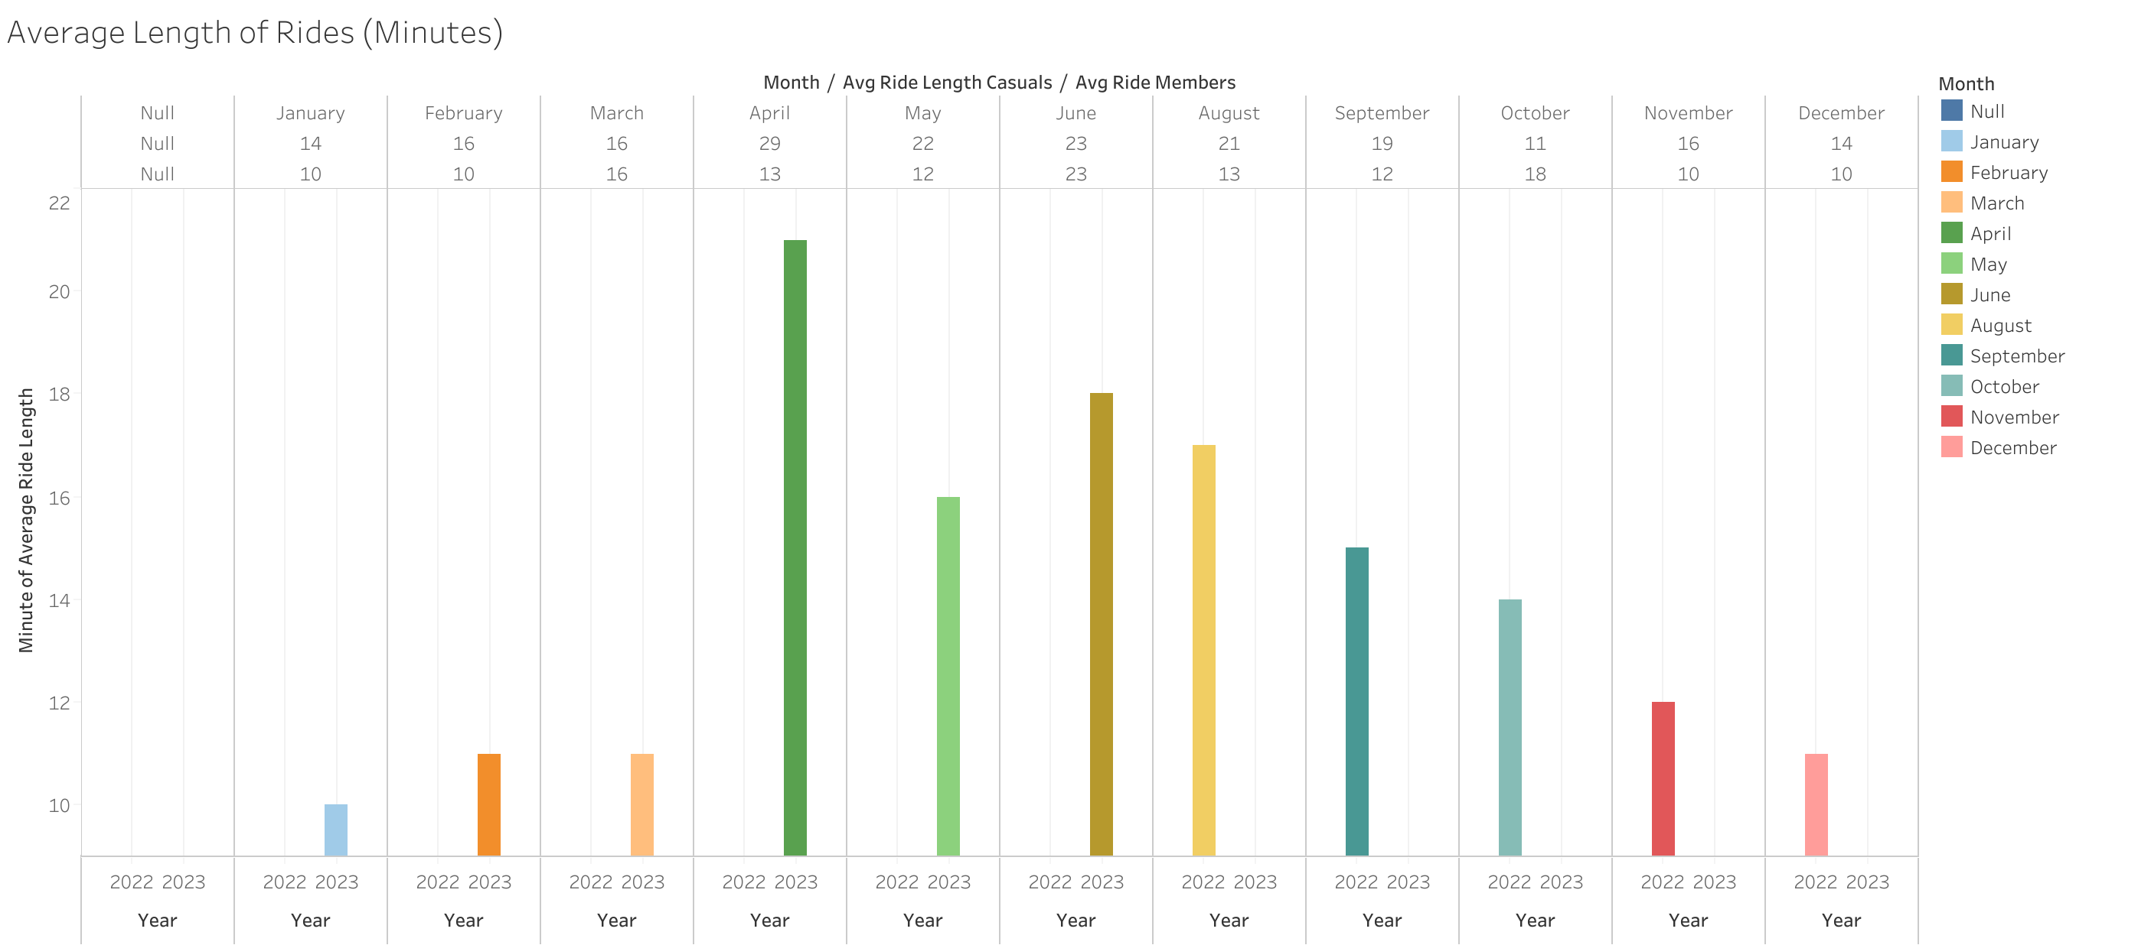
Notes:
https://public.tableau.com/app/profile/steven.monserrate/viz/GoogleDataAnalyticsProject-Cyclisticpt_2/Sheet1
In the most popular month, April, casuals rode more than twice the length of members!

Slide 13
Differences
Casuals have longer rides across the board
Members did not seem to ride docked bikes at all
The days of the week were vastly different, with members preferring day 5 and casuals day 7
Notes:
Overall, I noticed that causals not only ride more frequently, but they take longer trip than our members. Casuals also seem to enjoy all three types of bikes, whereas members didn’t seem to care about bikes at all. Finally, casuals prefer to ride Sunday, compared to the members preferring Friday

Slide 14
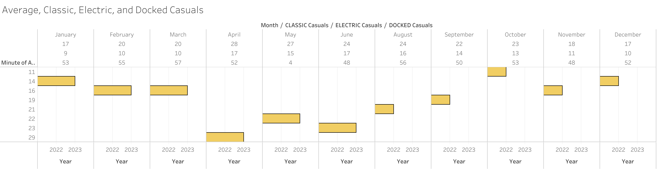
Notes:
https://public.tableau.com/app/profile/steven.monserrate/viz/GoogleDataAnalyticsProject-Cyclisticpt_3/Sheet2
In this graph, we see the difference between Casuals who rode Classic, Electric and Docked bikes. I found that Docked bikes had the longest duration of rides, but Electric bikes were much more frequently chosen.

Slide 15
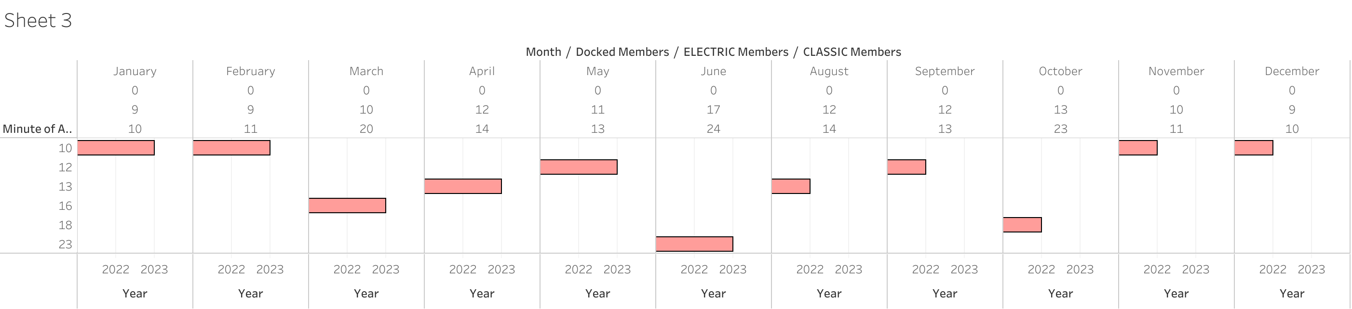
Notes:
https://public.tableau.com/app/profile/steven.monserrate/viz/GoogleDataAnalyticsProject-Cyclisticpt_4/Sheet3
For member riders, Electric bikes had both the longest and most frequent rides. Interestingly, members entirely avoided the Docked bikes!

Slide 16
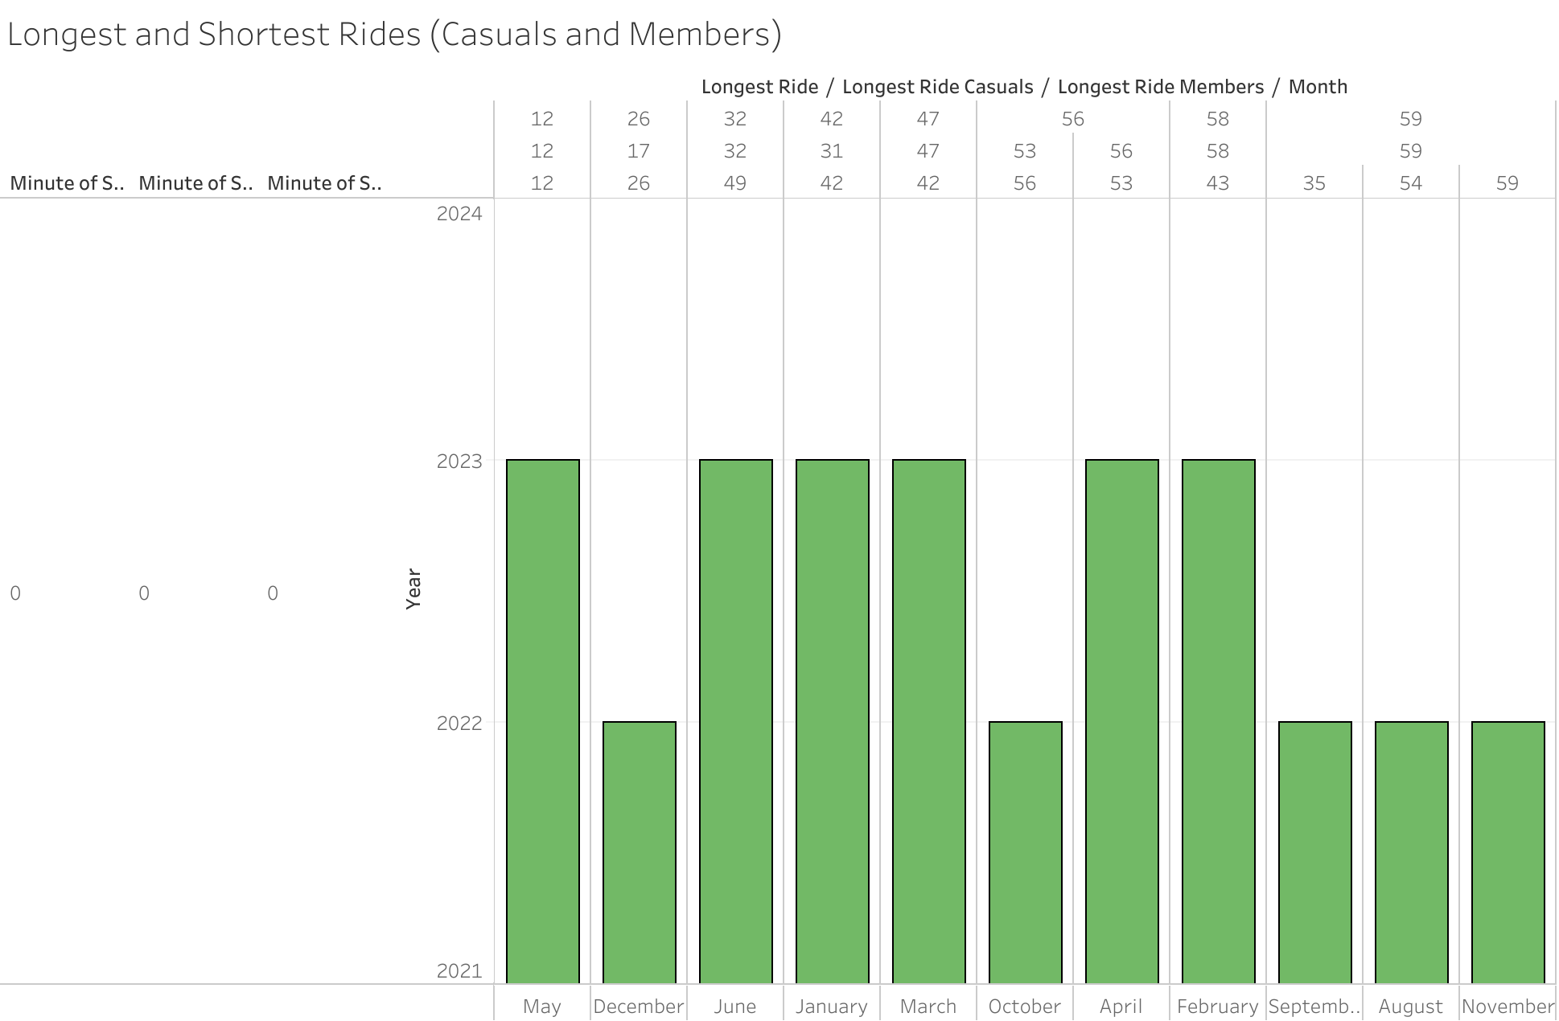
Notes:
https://public.tableau.com/app/profile/steven.monserrate/viz/GoogleDataAnalyticsProject-Cyclisticpt_5/Sheet4
Generally speaking, Casuals had the larger rides. There were a few months where members beat them out, but that was an exception and not the norm.

Slide 17
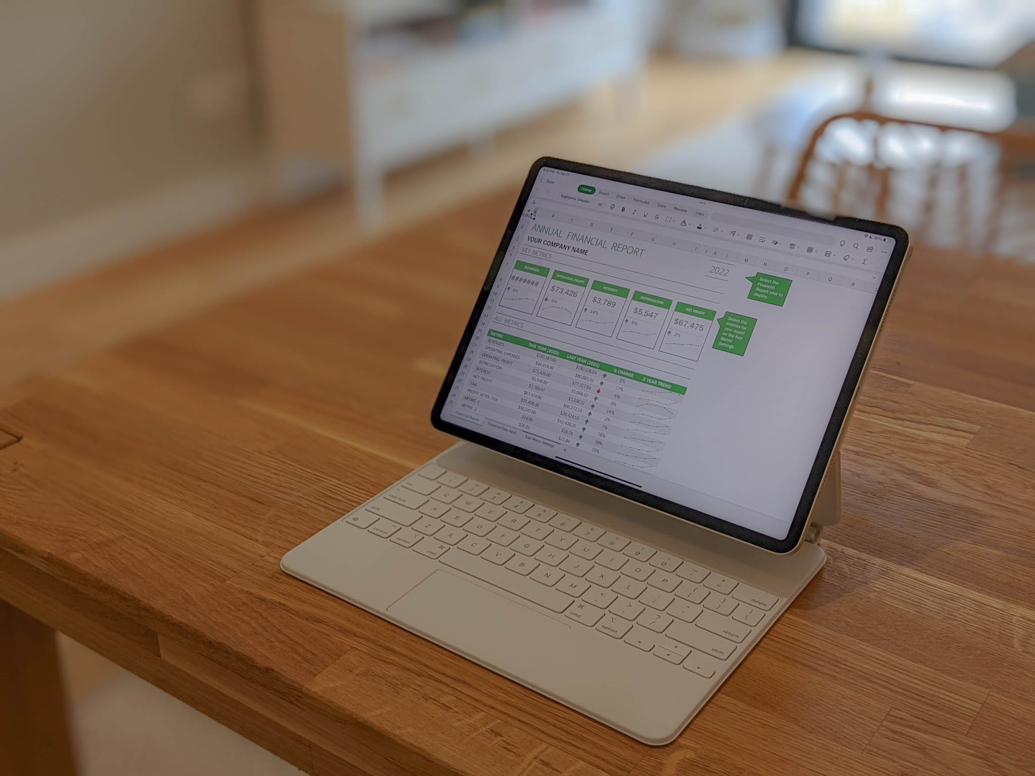
The Data Collecting Process

Slide 18
The Data Collecting Process
Cleaning Excel Data, removing duplicates, 0 values, and impossible numbers
Reviewing data and categorizing it in more clear ways
Organizing spreadsheets so that they only reflected July 2022-June 2023
Notes:
In order to collect all of my data, I downloaded the Excel sheets from Cyclistic that showed 7/22 – 6/23. I also needed to clean, edit, and remove any incorrect or impossible information

Slide 19

Uploading Information with SQL/BigQuery

Slide 20
Uploading Information with SQL
Converted Excel sheets to .CSV files
Split .CSV files so that they could be uploaded to Bigquery
Continued to clean missed problem cells and other necessities
Notes:
Using BigQuery was a hassle without the membership. I ended up having to split the .CSV files into 2 parts in order to upload certain months. Also, BigQuery found incorrect values that were initially overlooked. I deleted or corrected those as well. One common problem that I had was figuring out what to do with low values. Did someone really rent a bike for 0 or 1 seconds? Maybe? In the future I would consider deleting values under 2 minutes.

Slide 21
SQL Coding
Developed various SQL queries to obtain information relating to popular times of travel, preferred bike types, and longest and shortest rides
Examples in following sheets
Notes:
Using SQL only netted some returns, not all.

Slide 22
Examples Pt. 1
MAX Ride Length
SELECT ride_id, member_casual, ride_length
From `Cyclistic_Bike_Data.April_2023_Trip_Data`
WHERE member_casual = 'member'
ORDER BY ride_length DESC
MIN for Annual by month
SELECT ride_id, member_casual, ride_length
From `Cyclistic_Bike_Data.April_2023_Trip_Data`
WHERE member_casual = 'member'
ORDER BY ride_length ASC
Notes:
These codes were how I found the MAX and MIN ride lengths for the month

Slide 23
Examples Pt. 2
SELECT ride_id, member_casual, ride_length
From `Cyclistic_Bike_Data.April_2023_Trip_Data`
WHERE member_casual = 'member' AND ride_length = '00:00:02'
ORDER BY ride_length ASC
SELECT day_of_week, member_casual
FROM `Cyclistic_Bike_Data.April_2023_Trip_Data`
WHERE day_of_week = 1 and member_casual = 'member’
Notes:
These codes were the same, but for members

Slide 24
Examples Pt. 3
SELECT ride_length
FROM `Cyclistic_Bike_Data.April_2023_Trip_Data`
WHERE member_casual = 'casual'
ORDER BY ride_length DESC
SELECT ride_length
FROM `Cyclistic_Bike_Data.April_2023_Trip_Data`
WHERE member_casual = 'casual'
ORDER BY ride_length ASC

Slide 25
Examples Pt. 4
SELECT ride_id, rideable_type, member_casual
FROM Cyclistic_Bike_Data.April_2023_Trip_Data
WHERE rideable_type = 'docked_bike' and member_casual = 'casual’
SELECT day_of_week, member_casual
FROM `Cyclistic_Bike_Data.April_2023_Trip_Data`
WHERE day_of_week = 7 and member_casual = 'casual'
Notes:
And these codes helped me find the preferred bike type of both groups, and the most popular day to go riding (it was Sunday by a sizeable margin)

Slide 26
Using Excel to Fill in the Blanks
Certain pieces of information like the Average were inaccessible on SQL
Used Excel Columns and Tables to collect the Averages for riders
Also uploaded everything onto a separate Excel sheet to be uploaded into Tableau later
Notes:
After a lot of struggles, I was able to use Excel’s features to find the Averages for all three categories. I also made a separate Excel sheet to upload into Tableau

Slide 27

Tableau

Slide 28
Tableau
Used Tableau to make graphs and charts of data
Converted primary Excel chart into a .CSV for easier uploads
Notes:
Tableau was a life saver and made awesome information graphics. I will definitely be using this service more in the future.

Slide 29
What We Know Now
Cyclistic members do not used docked bikes
Both members and casuals prefer electric bikes the most
Cyclistic casuals tend to have longer rental times than their member counterparts
Notes:
We know for sure that members and casuals think and act very differently. Casuals tended to spend around an hour on docked bikes, and members didn’t ride them at all. The electric bikes were the most loved across the board, and casuals tended to rent the bikes longer than members

Slide 30
Why Would Cyclistic Casuals Become Members?
Offer discounts and deals on electric bike rides
Incentivize the product as an easy way to get around Chicago, cheaper and safer than driving
Make docked bikes more appealing by making them either discounted or a member exclusive
Notes:
The best way to coax casuals to become members is to offer them incentives. By discounting the popular electric bikes, advertising them as alternative modes of travel in Chicago, and putting Docked bikes behind a paywall, we could get more people interested in membership

Slide 31
Advertising to Non-Members
By participating in various health campaigns, and clean energy movements, Cyclistic can greatly impact its marketshare
Participate as a sponsor in bike races in Chicago, giving awards and prizes to members who participate
Sponsoring eco-friendly movements and offering a way to clean up pollution in Chicago in a cheap and affordable way
Notes:
Advertising to non-members doesn’t need to be difficult. We can participate in various community events, sponsorships, and campaigns to garner more attention and involvement. Making our bikes part of a healthy lifestyle will result in them being seen as a reasonable expense.

